Slide 1

Chocolates – Text Analytics and NLP
Team 8 –
Bashar
Savi
Mo
Haolian
Diego
Mayank

Slide 2
The Business Case
We have been hired to carry out research to understand customer feelings towards chocolates and their expectations regarding the taste, quality and content of chocolates they purchase. As a team, we have carried out a survey to find out whether customers would be interested in purchasing chocolate that has been created to suit their personality types.
Our findings are as follows:

Slide 3
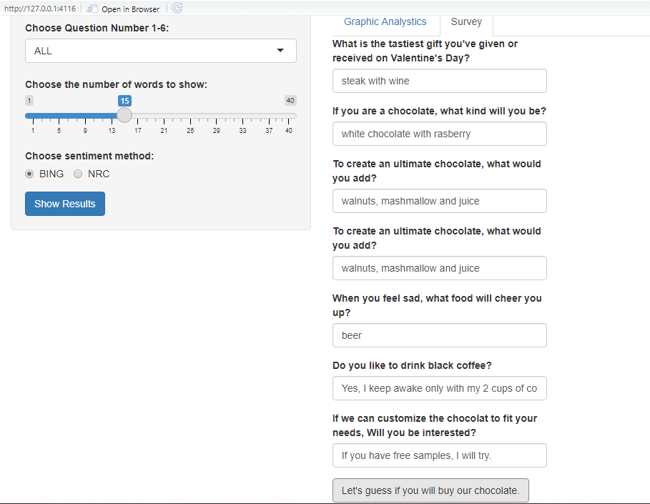
Survey Questions
These questions help us gain insight to what expect from our chocolate

Slide 4
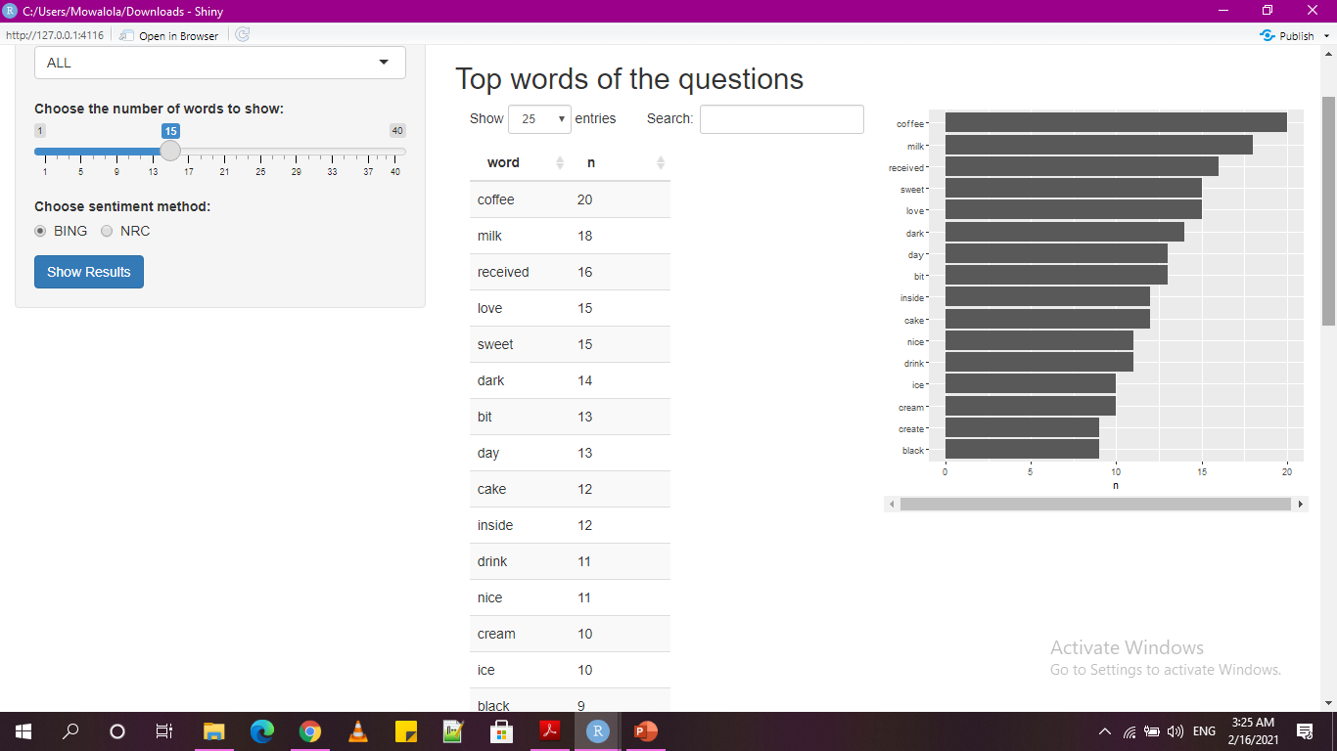
Filtering for top words

Slide 5
Histogram of Top Words
Based on the number of top words selected by user input, a histogram is created.

Slide 6
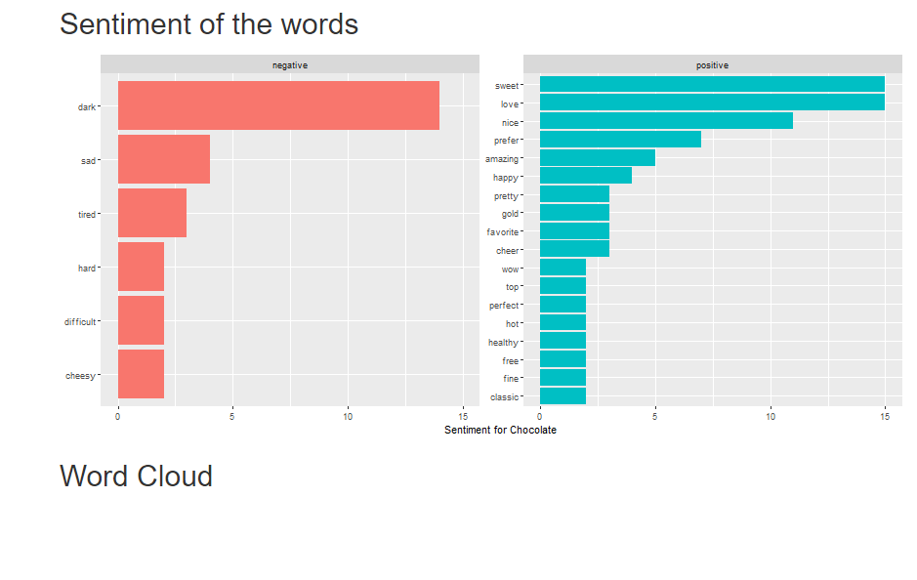
Sentiment Analysis
Next, we perform a sentiment analysis of the top words.

Slide 7
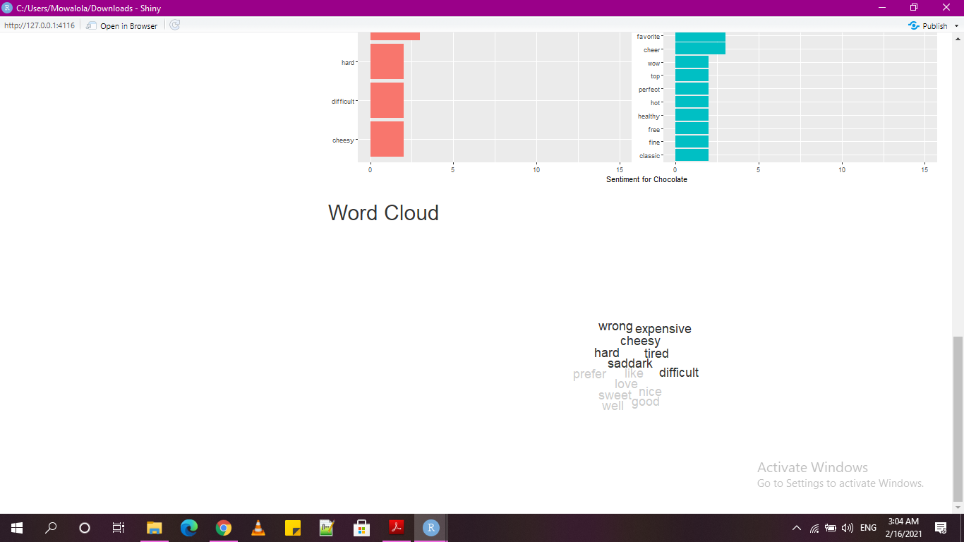
Word Cloud

Slide 8
Conclusion

Slide 9
THANK YOU!

